Slide 1
Prediction
Predict a continuous value, rather than a categorical label
Predict the salary of college graduates with 10 years of work experience
Potential sales of a new product given its price
Regression is most widely used approach for such numeric prediction

Slide 2

Prediction
Regression is most widely used approach for such numeric prediction
Relationship between independent/predictor variable and dependent/response variable
A Linear regression example:
Or, Equivalently

Slide 3
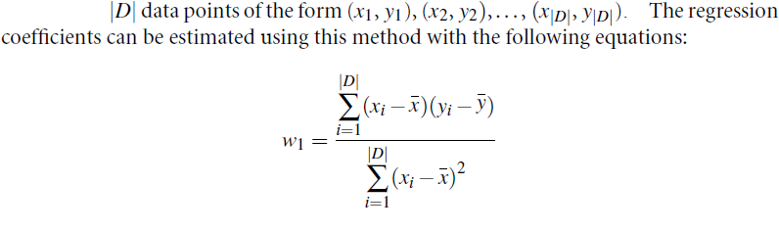
Prediction
Regression is most widely used approach for such numeric prediction
Relationship between independent/predictor variable and dependent/response variable
A Linear regression example:
Or, Equivalently

Slide 4
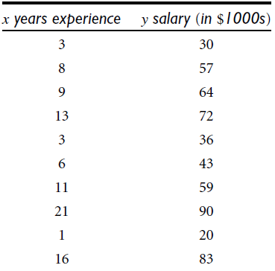
Regression Example

Slide 5
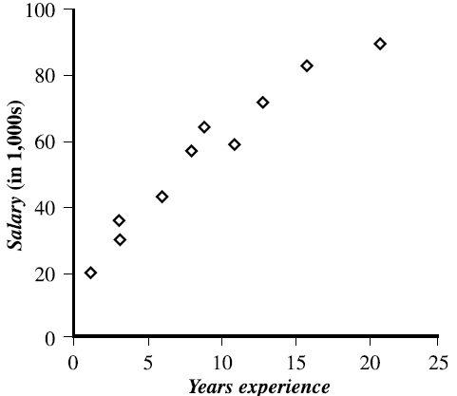
Regression Example

Slide 6
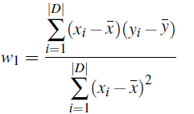
Regression Example
What would be a salary of a person with 10 yrs experience?
Solve the equation:
Using:

Slide 7
Regression Example
What would be a salary of a person with 10 yrs experience?
Solve the equation:
Using:
w₁=3.5

Slide 8
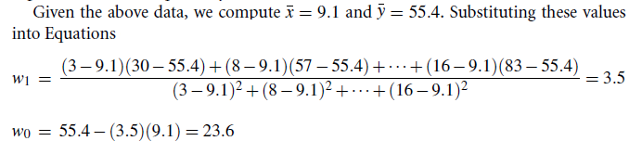
Regression Example

Slide 9
Regression Example
What would be a salary of a person with 10 yrs experience?
Put in the equation
The salary y =

Slide 10
Thank You!

